Slide 1


PROJS 30001.1: PROJECT PLANNING
Notes:
Introduce yourself: Name, Specialization, Semester

Slide 2
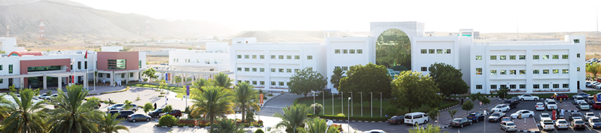
Chapter 1: Introduction
Title of the Project: Construction management system for Abu Abeer al Gawabry trading using python and django
Short Overview of the Project/Background
Founded in 2004
The company specializes in the trading of construction materials such as plywood, products that are based on plywood,
Scope: Make workflow simpler
This will benefit the Manager, employees as well as the customers who choose to use the system.
The primary objective of this project is to deliver an inventory management system that is efficient.
Notes:
A brief introduction about your project.

Slide 3
AIM of the Project: The primary aim of the project will be designing and developing a construction material management system for, and organization called Abu Abeer al Gawabry trading.
Objectives:
A better user interface, Signup, login function for staff and customers, Forgot password function, Reset password, Create, update,
delete (CRUD) function for employees and manager,
Supply system, Order system, Billing system, Viewing employee and customer details, Calculation functions etc.
Stakeholders: Internal Employees, Manager , Shareholder, Admin
External- Supplier, Customer, Middle East College, Other interest groups such as competitors, community groups and pressure groups, Internet service providers
Reasons for Project Choice: Project is challenging and helps learn new programming language and help in problem solving
Notes:
A business process is a collection of activities that takes one or more kind of input and creates an output, such as a report or forecast, that is of value to the customer.

Slide 4
Chapter 2: Literature Review
and Feasibility
Sample of Similar Work/Applications: Silver Inventory system, Zoho, Cin7, Brightpearl
Feasibility: Technical, Operational, Economic, etc. of the project
Technical- uses free tools to make such as VSCode, Bootstrap, python
Operational- Easy to use and user friendly
Economic- Free to use and will prove beneficial
Notes:
A brief introduction about your project.

Slide 5
Chapter 3: Methodology
Comparison of the Methodology: Waterfall(Linear), Spiral(iterative),DSDM(agile)
Waterfall, spiral- No user feedback, No predictability, Customer priority is high water fall doesn’t work well for big projects
Selected Methodology: DSMD Was chosen
Satisfies customers and stakeholders, Works well for big projects
Data Collection: Survey and interview
Notes:
A brief introduction about your project.

Slide 6
Survey Results
Q1) Gender
Q2)experience with inventory management systems

Slide 7
Survey Results
Q3) Rate the current system
1-vsatisfied,5-Unsatisfactory
Q4) Security concerns of the current system

Slide 8
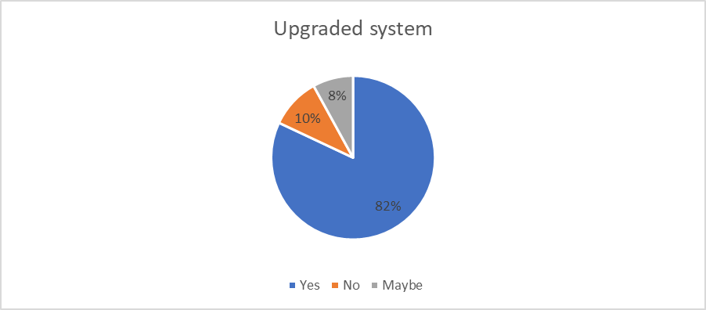
Survey results
Q5 Facing difficulty in using the system
Q6) Do you want a better system?

Slide 9
Survey results
Q7) Difficulty in using the system

Slide 10
Chapter 3: Methodology
Functional and Non-Functional Requirements of the System:
Functional- A suitable UI should be included
Login and logout should be possible
Should be compatible with any windows version
Non Functional: How The System Performs A Certain Function
Usability
Security
Maintainability
Scalability
Notes:
A brief introduction about your project.

Slide 11
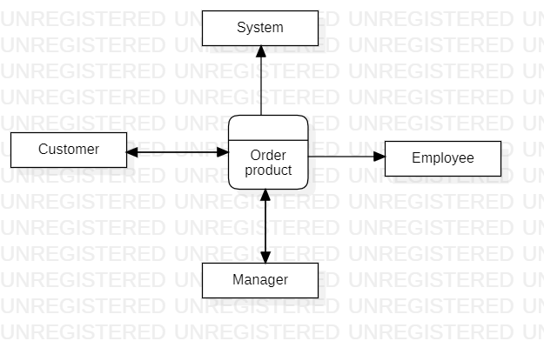
Diagrams: Context, DFD: Level 0 1 2, Use Case, Flowchart, ERD, etc.
Context:
Notes:
A brief introduction about your project.

Slide 12
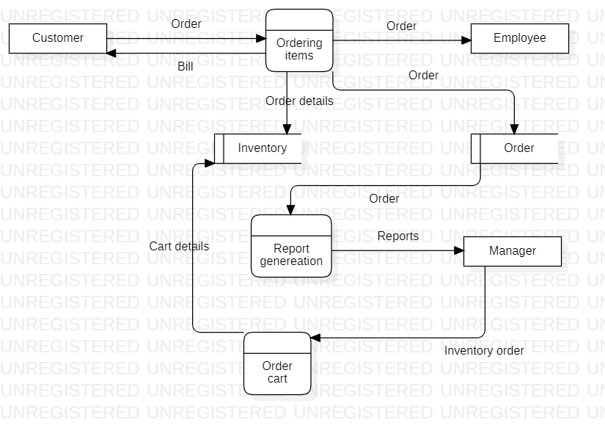
Diagrams: Context, DFD: Level 1 , Use Case, Flowchart, ERD, etc.
DFD Level 1
Notes:
A brief introduction about your project.

Slide 13
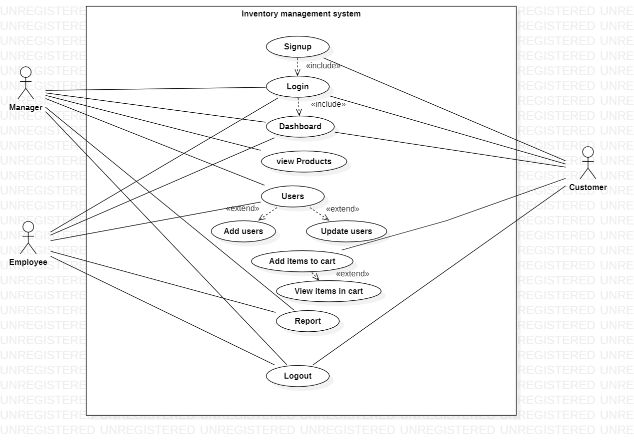
Diagrams: Context, DFD: Level 1 , Use Case, Flowchart, ERD, etc.
Use Case
Notes:
A brief introduction about your project.

Slide 14
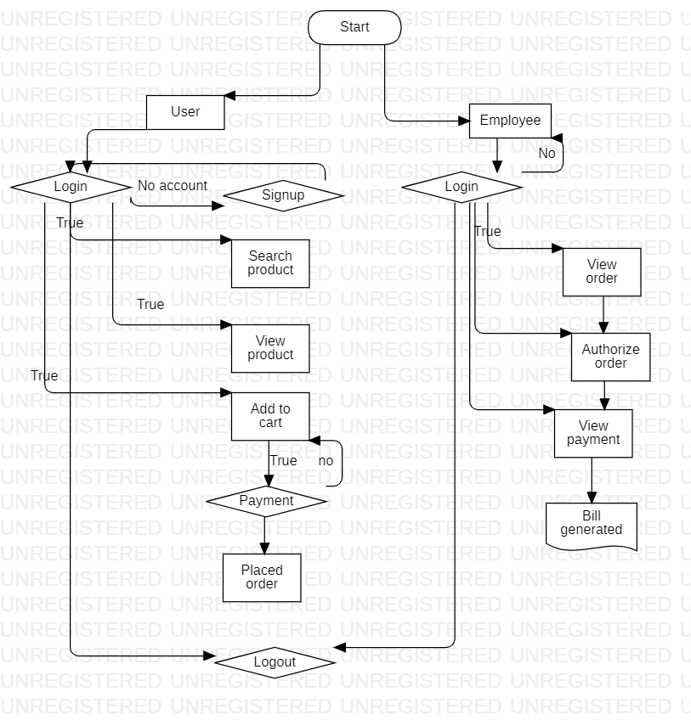
Diagrams: Context, DFD: Level 1 , Use Case, Flowchart, ERD, etc.
Flowchart
Notes:
A brief introduction about your project.

Slide 15
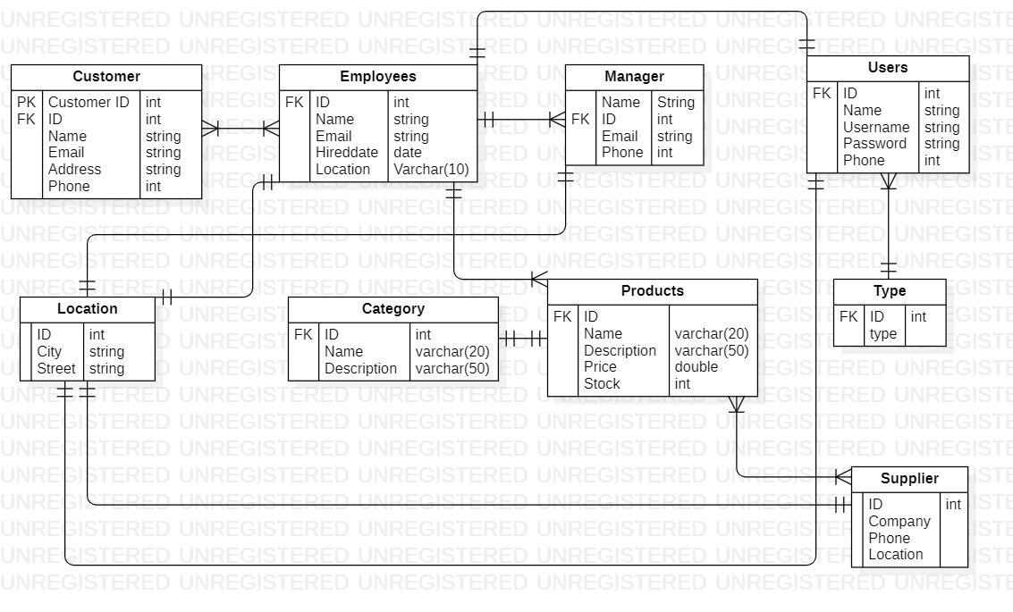
Diagrams: Context, DFD: Level 1 , Use Case, Flowchart, ERD, etc.
ERD:
Notes:
A brief introduction about your project.

Slide 16
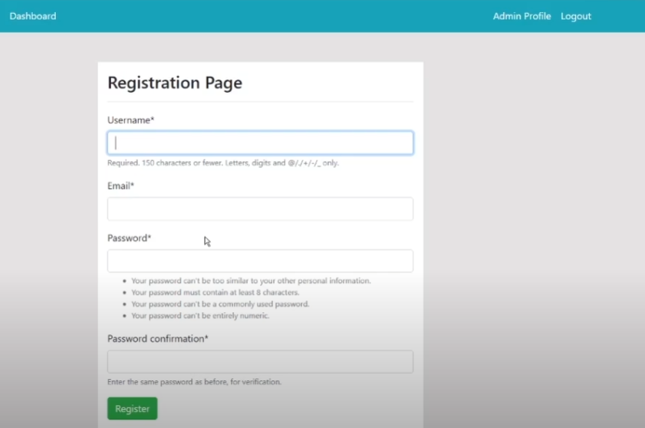
Sample of project
Registration:
Notes:
A brief introduction about your project.

Slide 17
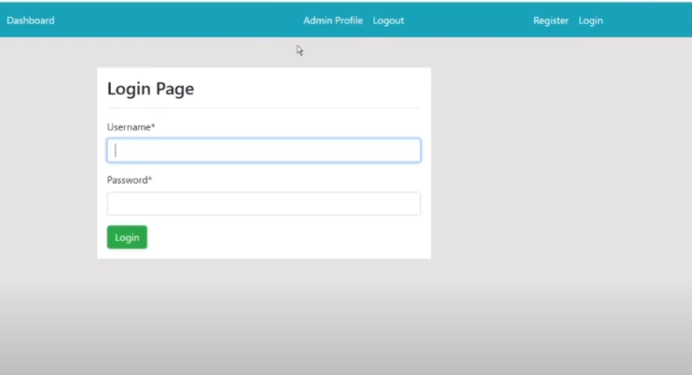
Sample of project
Login:
Notes:
A brief introduction about your project.

Slide 18
References

Slide 19
Thank You!

